Slide 1
Anomaly detection using unsupervised machine learning
Presented by:-
Pushpendra Kumar
Infosys springboard intern
Domain – AI
Group – 122

Slide 2
Problem statement
This project aims to develop a system using unsupervised learning to detect anomalies or potential fraud among healthcare providers based on their behavior and transaction data.
The system integrates diverse datasets for comprehensive analysis, extracts relevant features, and applies clustering and anomaly detection algorithms.
It aims to differentiate between normal variations and potentially fraudulent activities, establishing real-time monitoring and scoring mechanisms.

Slide 3
Healthcare Providers healthcare providers data(Kaggle.com)
Healthcare fraud represents a significant societal challenge, diverting funds intended for medication, elderly care, and emergency services towards dishonest practitioners or patients. This diversion contributes significantly to the escalating costs of healthcare amid rising expenditures.
This dataset is a collection of healthcare providers records, comprising 100,000 entries. It consists of various columns including index, National Provider Identifier(NPI), Name of Provider, Credentials, Gender, State Code, Number of Services, Average Medicare Amounts, etc.

Slide 4
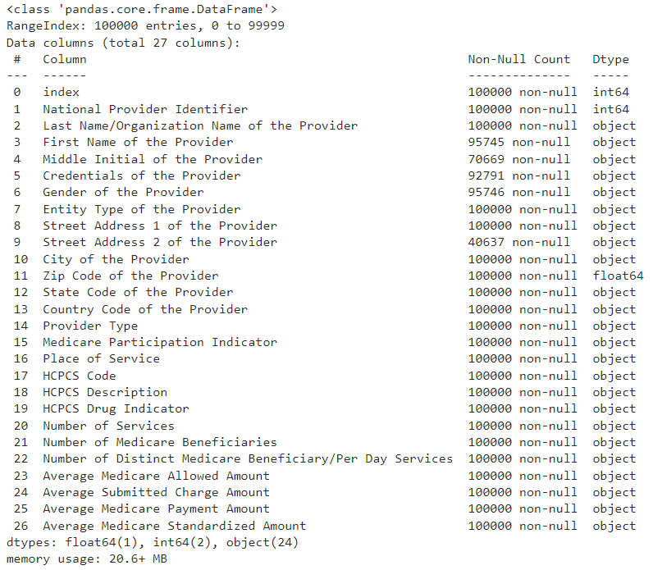
Dataset analysis
This dataset consists of total 27 columns having 100K of total entries.
There are 5 Categorical, 17 Texts, and 3 Numeric and 2 Boolean variables in the dataset.
It consists of various data types including object, float64, and int64.
There are total 104412 cells missing in the dataset which is 3.9% of total cells.
There is no any duplicate rows present in the dataset.

Slide 5
Exploratory data analysis (EDA)
The healthcare providers dataset is analysed thoroughly, all its features are observed and checked for its usefulness and importance in anomaly detection.
Pre-processing steps are followed such as: Handling missing values, Dropping unnecessary columns, Checking duplicates, and Filling null values with mode.
Data Cleaning is done by converting the object columns which are supposed to be numeric, removing any comma separators, and removing periods(.) from “Credentials of the Provider” column.
Data Visualization using various scatter plots (Univariate and Bivariate Analysis).
Normalization, Standardization, and Encoding.
Dimensionality Reduction using Principal Component Analysis (PCA).

Slide 6
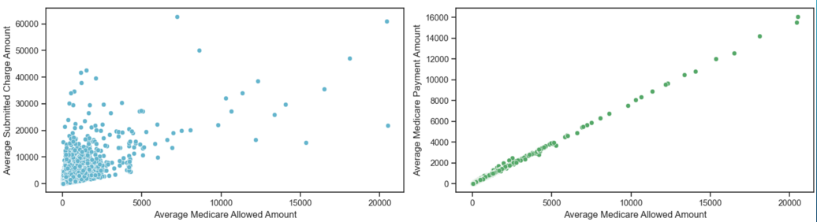
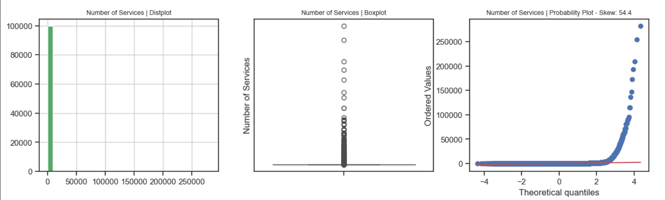
EDA Visualisation

Slide 7
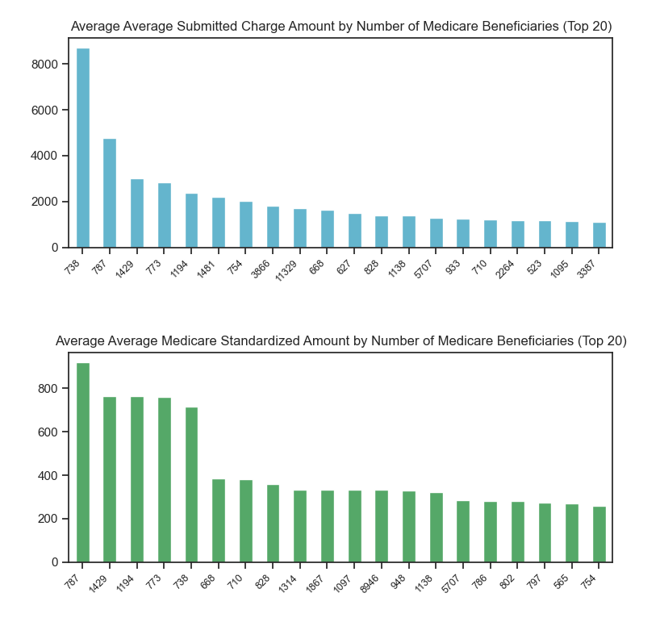
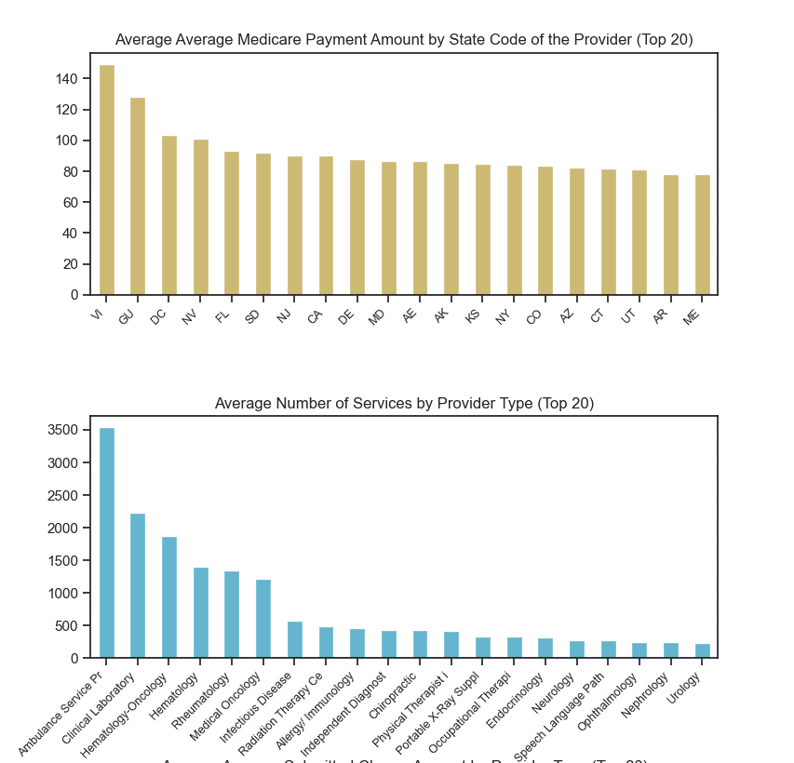
EDA Visualisation (CONTD.)

Slide 8
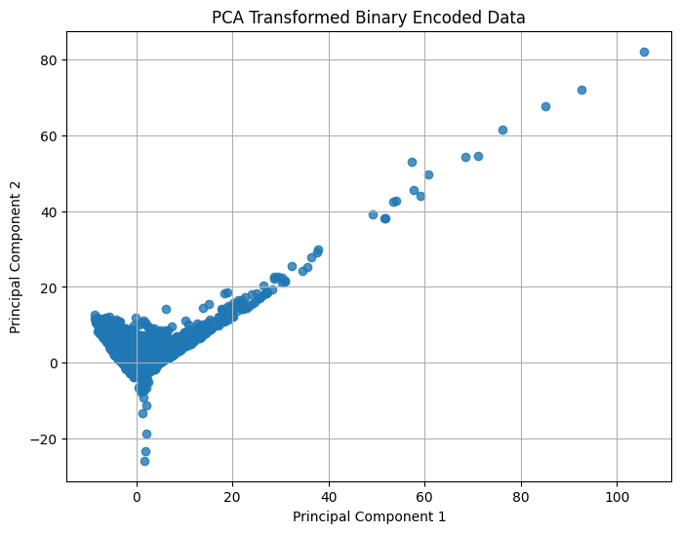
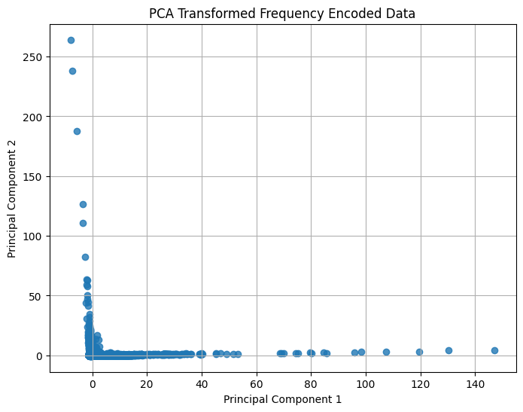
PCA Visualisation

Slide 9
Clustering Algorithms
K-means Clustering
DBSCAN Clustering

Slide 10
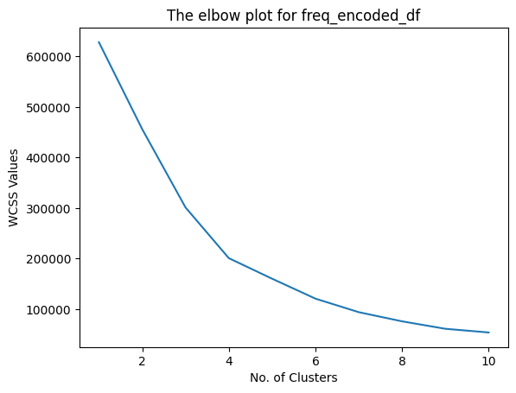
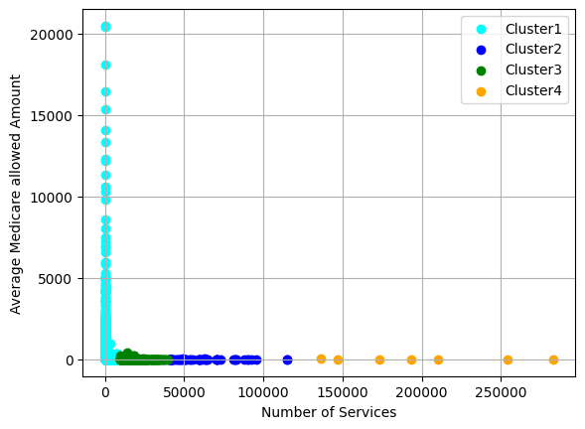
K-means Clustering
The 4 clusters formed by the distribution of values of “Number of Service” vs “Avg. Medicare Allowed Amount”.
The elbow plot above tells us the ideal number of clusters to be formed.

Slide 11
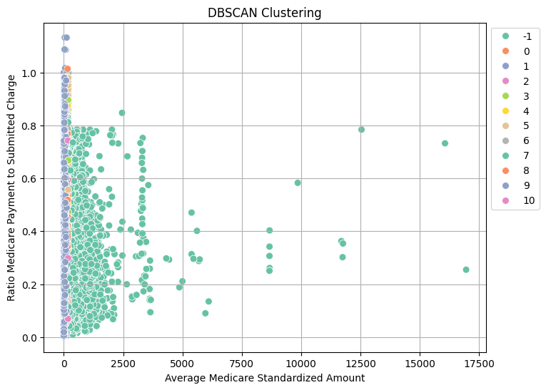
DBSCAN Clustering
Total 10 clusters are formed using DBSCAN clustering algorithm.
This plot shows the clusters formed by two features “Avg. Medicare Standardized Amount” vs “Ratio Medicare Payment to Submitted Charge”.

Slide 12
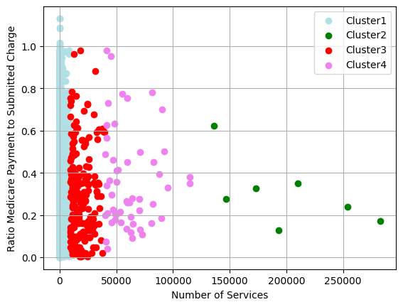
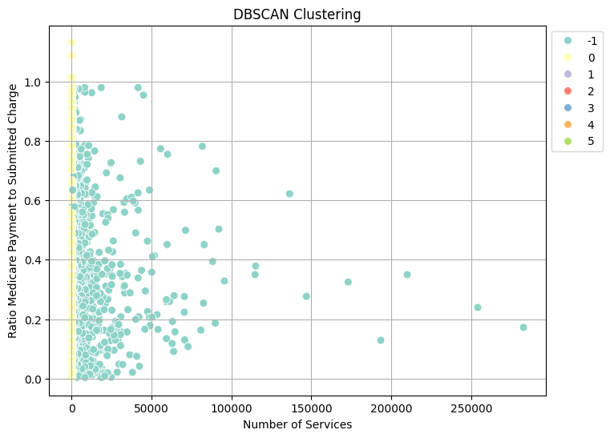
Clustering Comparison
K-means Clustering
DBSCAN Clustering

Slide 13
Machine learning Algorithms
Isolation Forest
Elliptic Envelope
One Class SVM

Slide 14
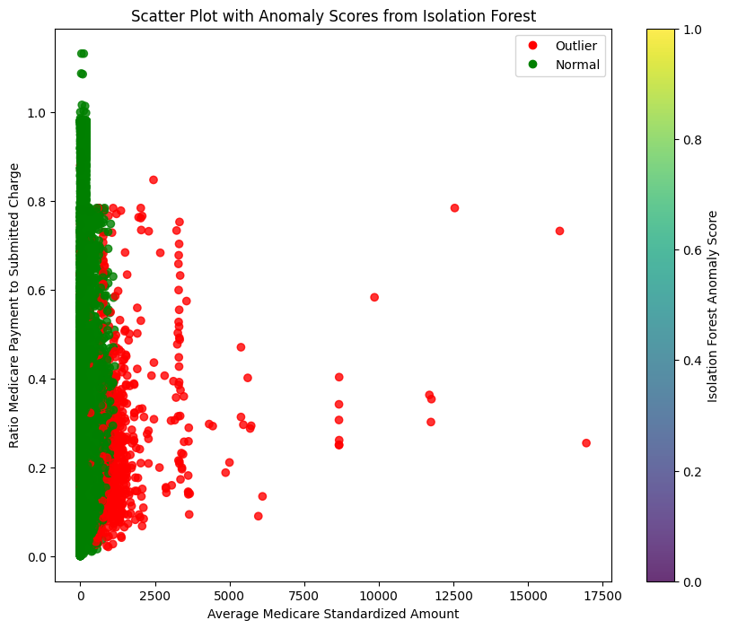
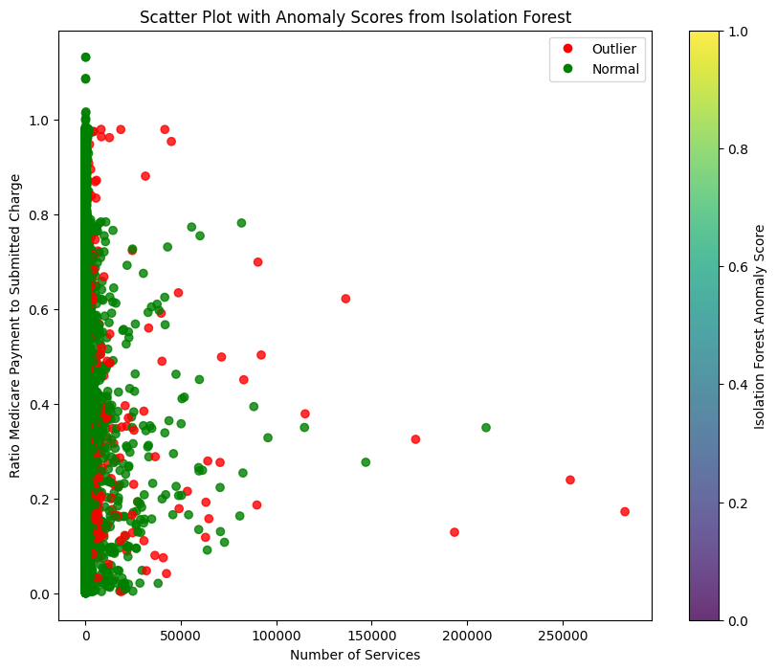
ML Algorithm (Isolation forest)
Anomalies Detected = 1000

Slide 15
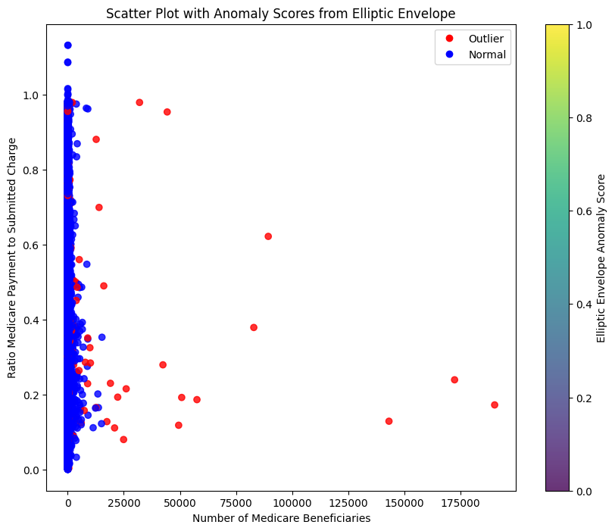
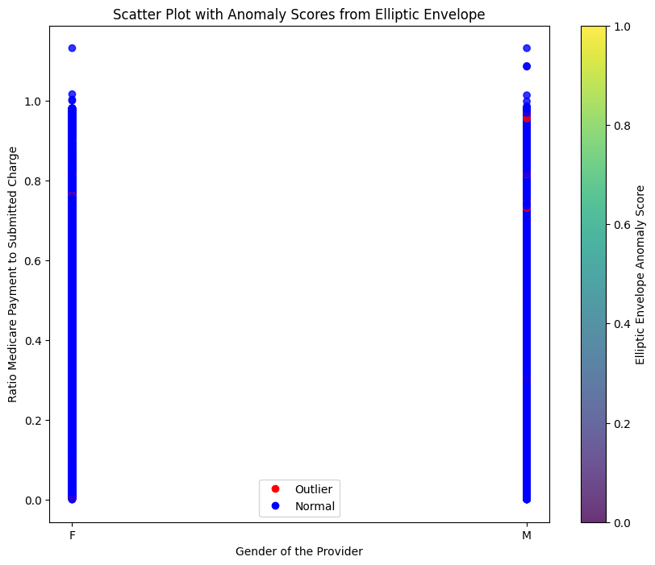
ML Algorithm (Elliptic envelope)
Anomalies Detected = 1000

Slide 16
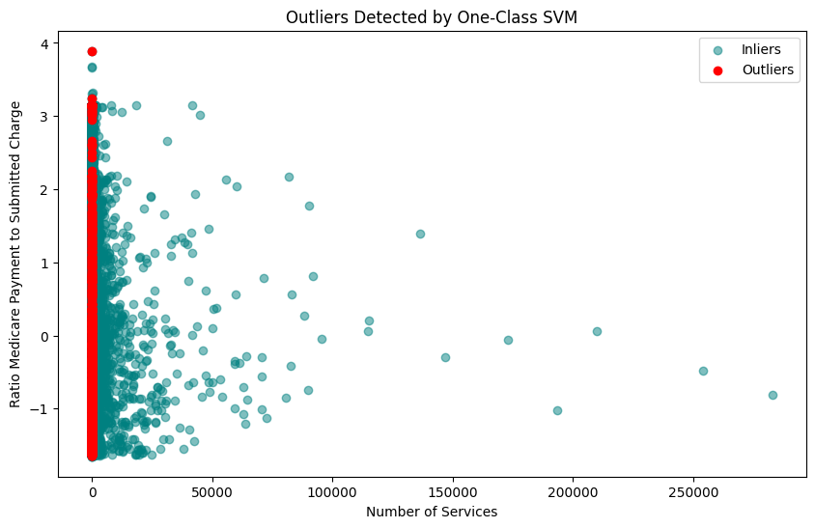
ML Algorithm (one class svm)
Anomalies Detected = 1002
Here, in One Class SVM Model, the total number of anomalies detected by setting the ‘nu’ value as ‘0.01’ are 1002.

Slide 17
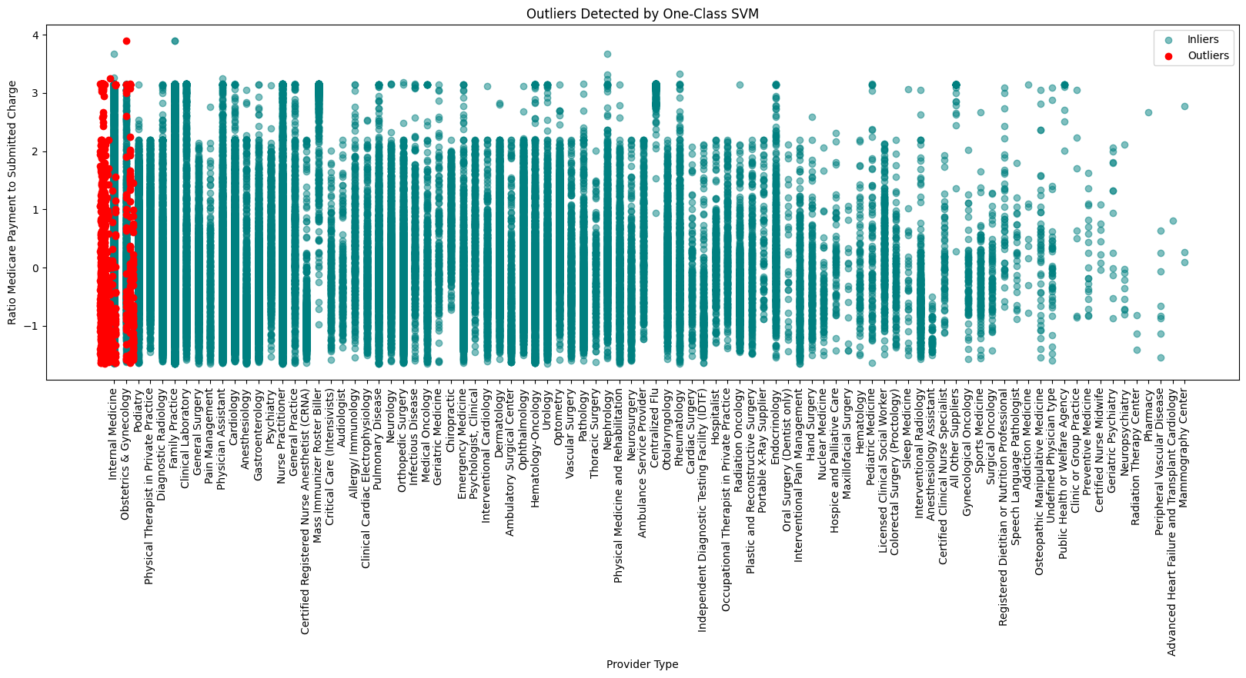
ML Algorithm (one class svm) (contd.)

Slide 18
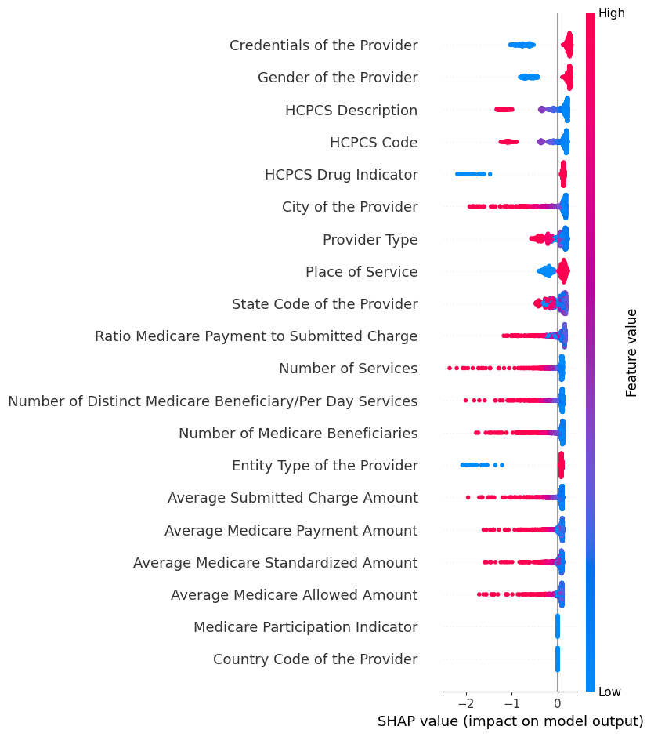
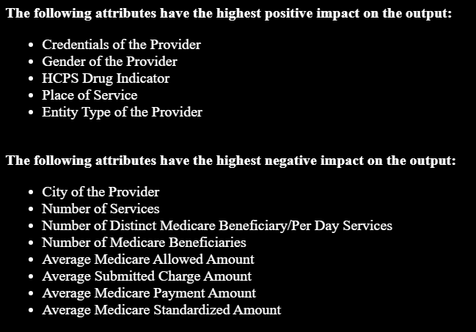
Shap analysis(isolation forest)

Slide 19
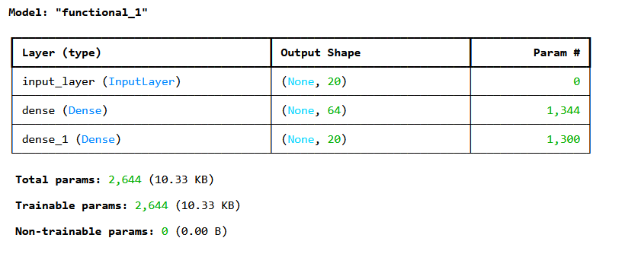
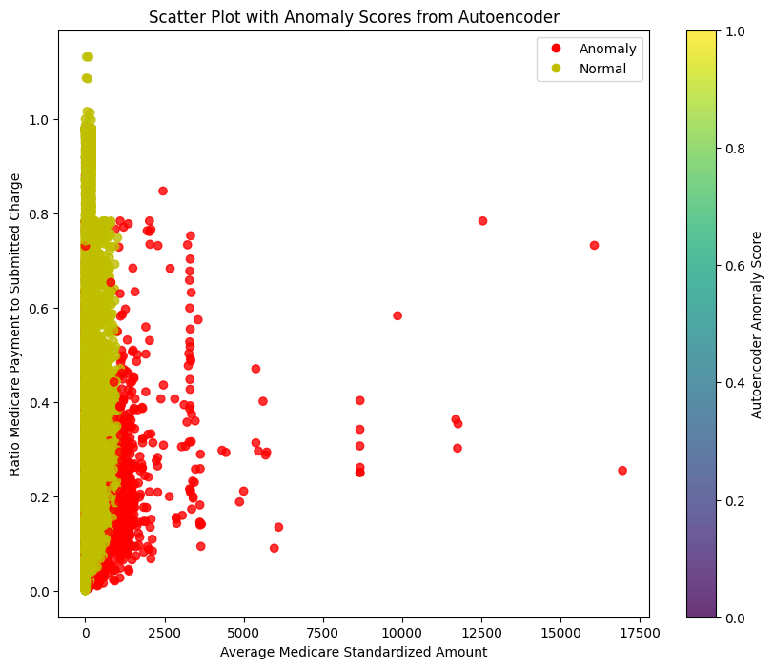
Auto encoders
Anomalies Detected = 1000
The input layer is having shape as (None, 20) and 0 parameters.
There are 2 dense layers having shape (None, 64) and (None, 20).
Total number of epochs = 30.

Slide 20
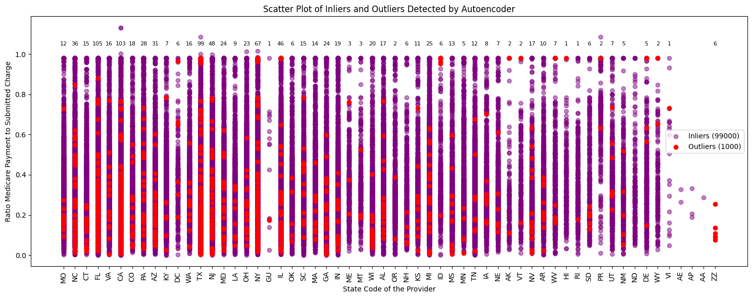
Auto encoders (contd.)
Most number of anomalies: Florida, California, and Texas.
Least number of anomalies: Armed Forces Europe, Armed Forces Central/South America, and Armed Forces Pacific.

Slide 21


